Slide 1


Wellcome
To
Ethical Hacking class
2nd Week
Day 4th
Muhammad Bilal

Slide 2
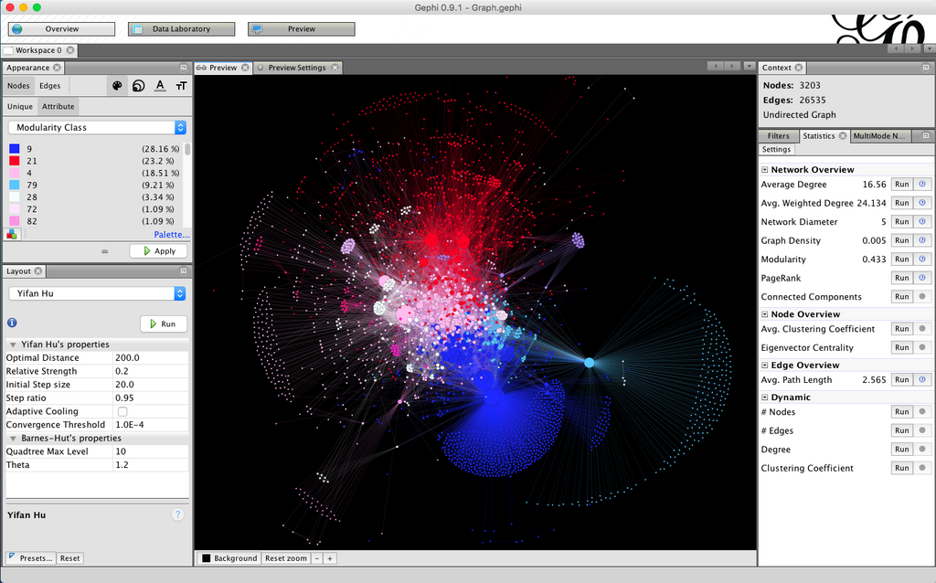
Visualizing OSINT Data
Definition:
Visualizing OSINT (Open Source Intelligence) data involves using graphical representations to make sense of complex data collected from publicly available sources. Visualization helps in identifying patterns, trends, and connections that might not be immediately obvious.
Examples:
1. Network Graphs: Display relationships between different entities, such as connections between social media accounts or links between websites.
2. Heatmaps: Show the geographical distribution of data points, like the frequency of cyber attacks in different regions.
Visualizing OSINT Data

Slide 3
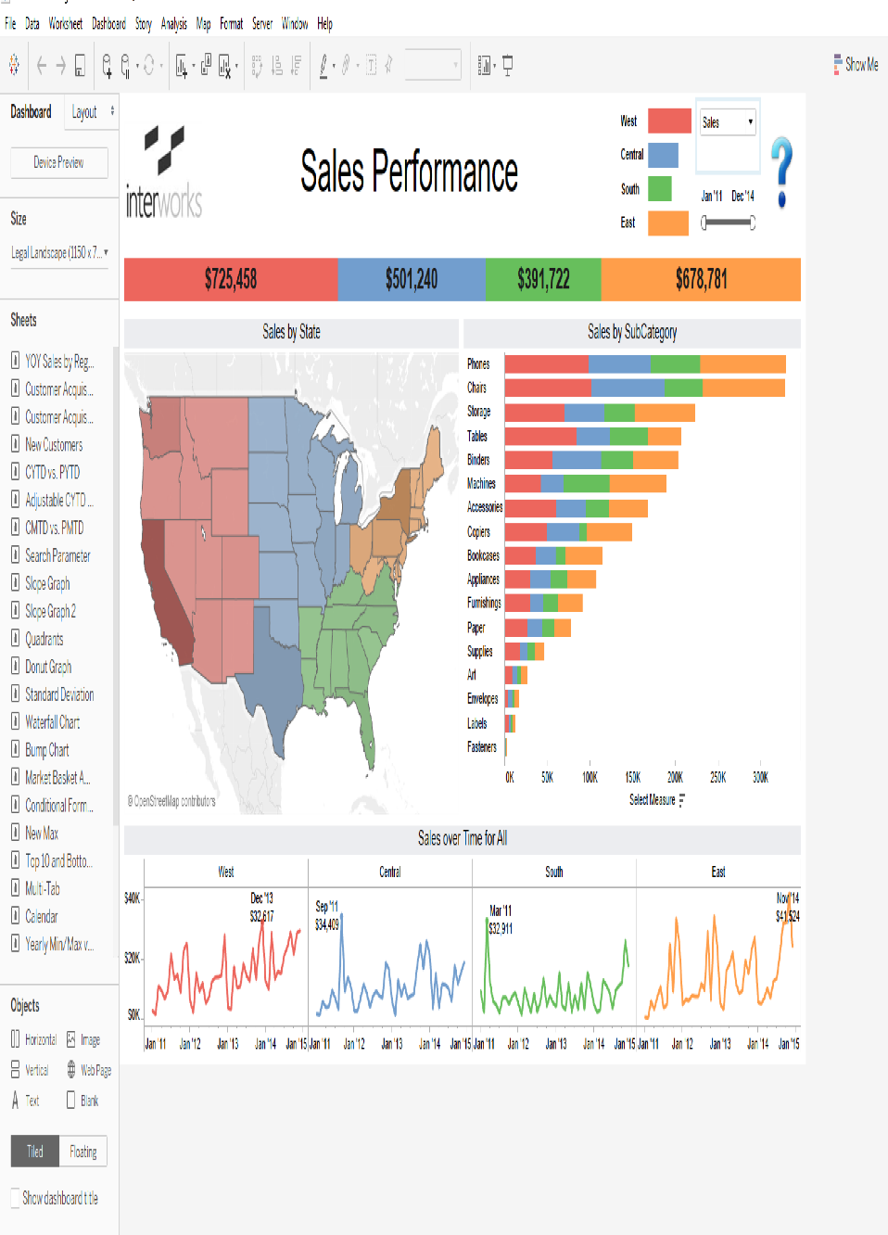
Visualizing OSINT Data
Techniques and Tools:
Gephi: An open-source network analysis and visualization software.
Maltego: A tool for graphical link analysis, used to visualize complex relationships between data points.
Tableau: A powerful data visualization tool that can be used to create interactive and shareable dashboards.
Graphistry: A platform that accelerates visual investigation of big data using GPU-powered graph analytics.
Visualizing OSINT Data

Slide 4
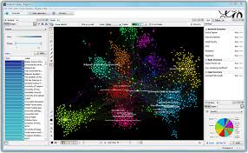
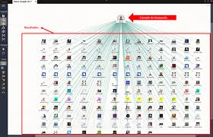
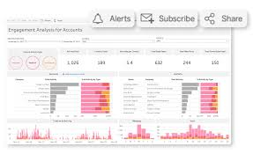
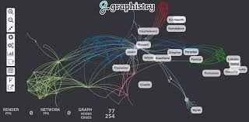
Visualizing OSINT Data
Gephi
Maltego
Tableau
Graphistry

Slide 5
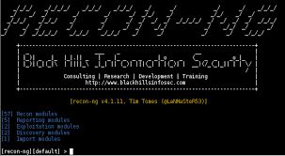
OSINT for Digital Forensics
Definition:
OSINT for Digital Forensics involves the collection and analysis of publicly available information to support investigations into digital crimes. This can include social media activity, public records, and other online data sources.
Examples:
1.Social Media Analysis: Investigating a suspect’s social media activity to uncover evidence or connections.
2.Domain and IP Investigations: Using OSINT to trace the origin and ownership of domain names and IP addresses linked to cyber incidents.
OSINT for Digital Forensics

Slide 6
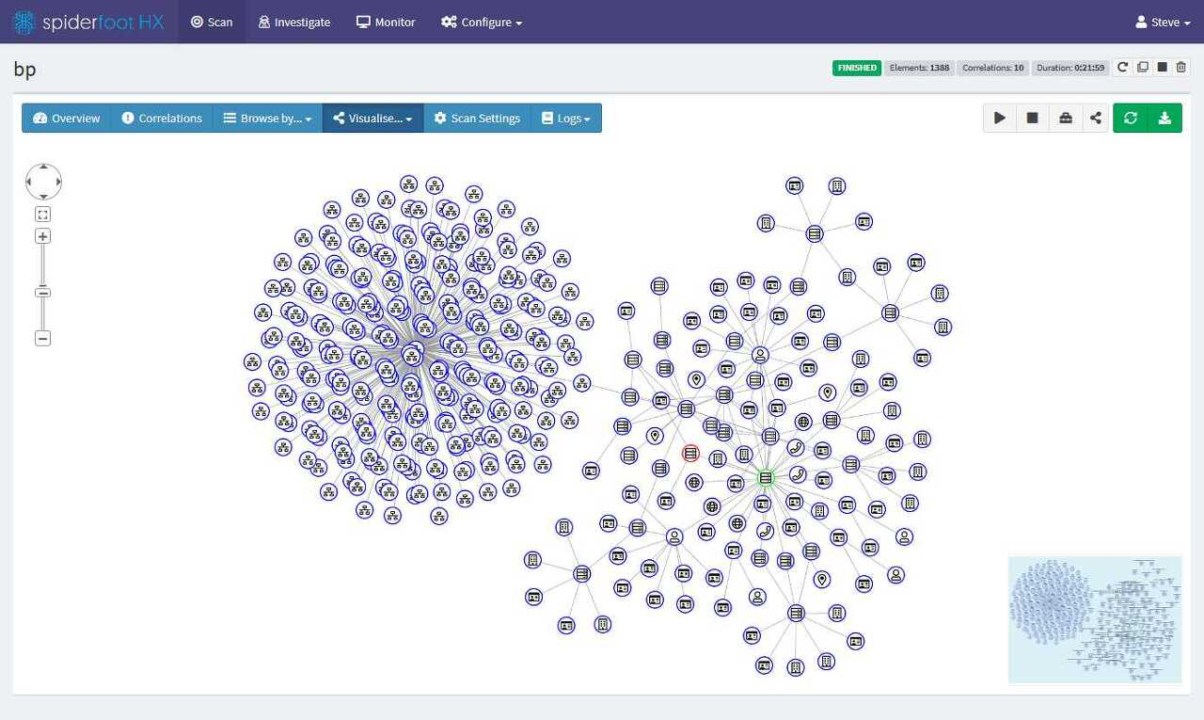
OSINT for Digital Forensics
Techniques and Tools:
Recon-ng: A full-featured web reconnaissance framework written in Python.
SpiderFoot: An OSINT automation tool that automates the process of gathering information.
Shodan: A search engine for internet-connected devices, useful for identifying vulnerable systems.
TheHarvester: A tool for gathering emails, subdomains, hosts, employee names, and open ports from different public sources.
OSINT for Digital Forensics

Slide 7
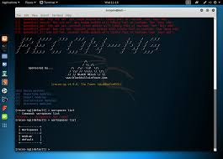

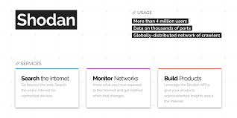
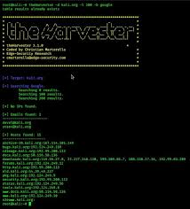
OSINT for Digital Forensics
Recon-ng
SpiderFoot
Shodan
TheHarvester

Slide 8
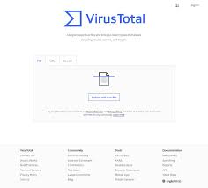
OSINT for Incident Response
Definition:
OSINT for Incident Response involves using publicly available information to respond to and mitigate cyber incidents. This can help in identifying threat actors, understanding the scope of an attack, and preventing future incidents.
Examples:
1.Threat Actor Profiling: Using OSINT to gather information about known threat actors and their tactics, techniques, and procedures (TTPs).
2.Phishing Incident Analysis: Collecting and analyzing data from phishing emails to identify patterns and potential sources.
OSINT for Incident Response

Slide 9
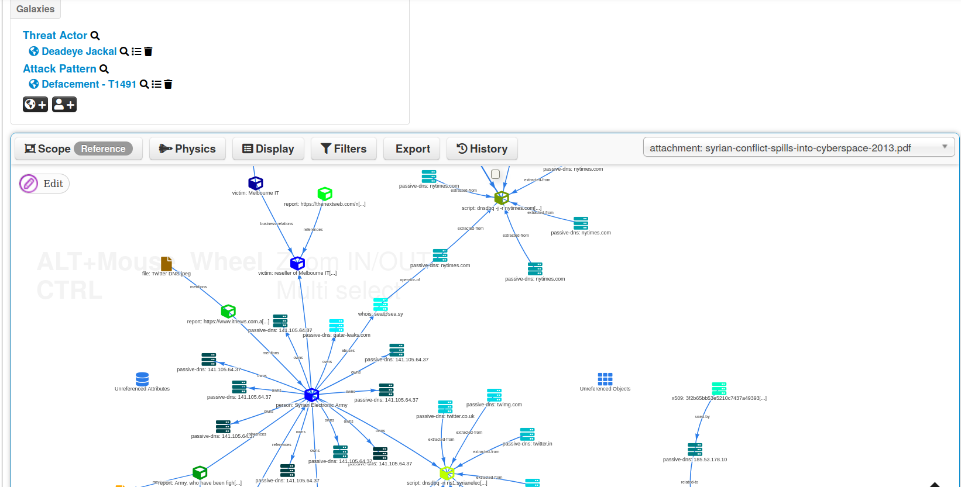
OSINT for Incident Response
Techniques and Tools:
VirusTotal: A free service that analyzes files and URLs for viruses, worms, trojans, and other malware.
Cymon: A community-driven threat intelligence aggregator.
AlienVault OTX: Open Threat Exchange, a platform for sharing threat intelligence.
MISP: Malware Information Sharing Platform, used for sharing, storing, and correlating Indicators of Compromise (IoCs).
OSINT for Incident Response

Slide 10
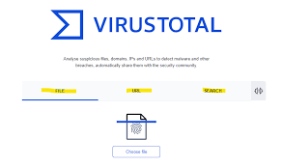
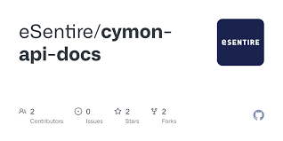

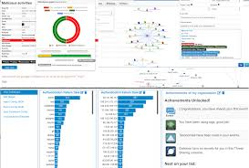
OSINT for Incident Response
VirusTotal
Cymon
AlienVault OTX
MISP

Slide 11
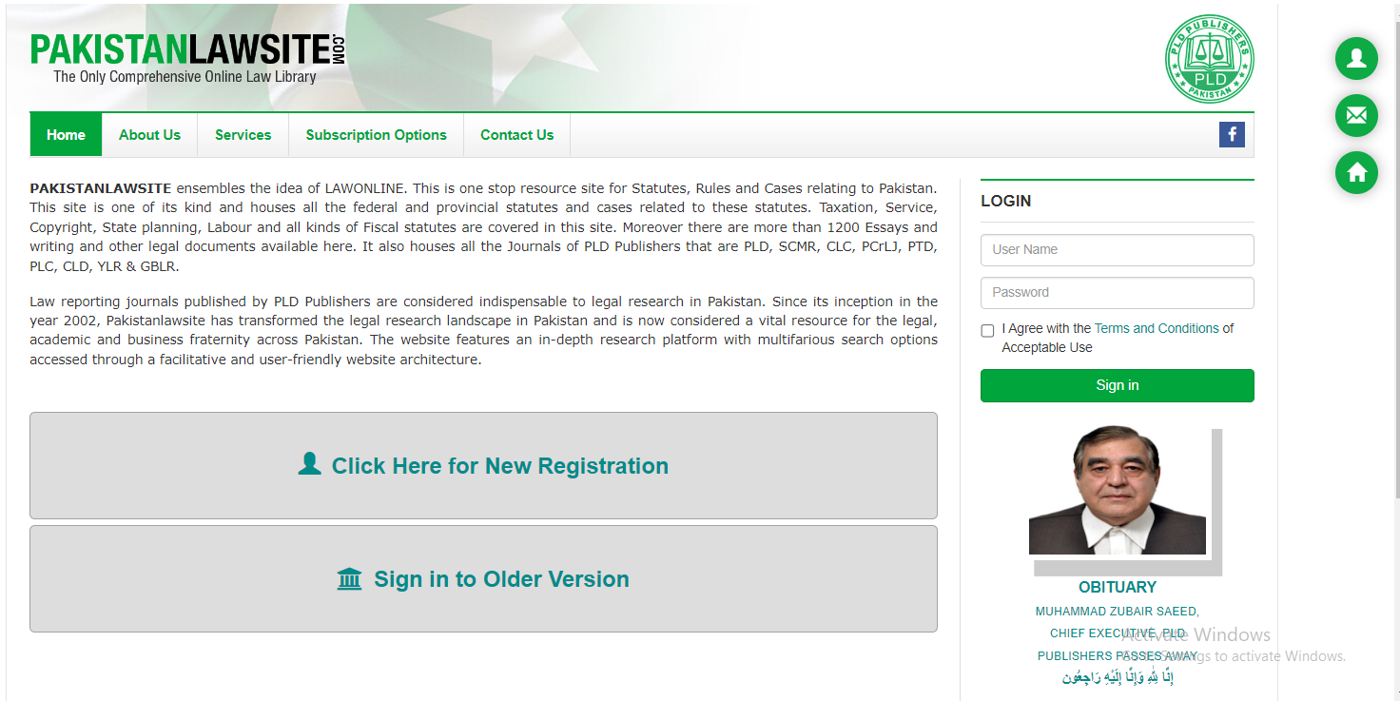
Legal and Ethical Aspects of OSINT
Definition:
The legal and ethical aspects of OSINT involve understanding the laws and ethical guidelines surrounding the collection and use of publicly available information. This includes respecting privacy rights and adhering to legal constraints.
Examples:
1.Compliance with Data Protection Laws: Ensuring that OSINT activities comply with laws such as the GDPR (General Data Protection Regulation) in Europe.
2.Ethical Considerations in Investigations: Balancing the need for information with respect for individual privacy and avoiding intrusive methods.

Slide 12
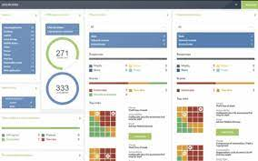
Legal and Ethical Aspects of OSINT
Techniques and Tools:
GDPR Compliance Tools: Tools and resources to ensure data collection methods are compliant with GDPR.
Ethical Guidelines Documentation: Organizations like the Electronic Frontier Foundation (EFF) provide guidelines on ethical information gathering.
Legal Databases: Accessing up-to-date information on relevant laws and regulations through legal databases and resources.

Slide 13
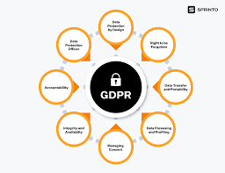
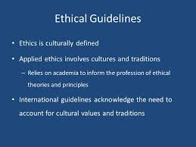

Legal and Ethical Aspects of OSINT
GDPR Compliance
Ethical Guidelines
Legal Databases

Slide 14

HAPPY HACKING

Slide 15
Thank You!

